Slide 1
Articles 1-3

Slide 2
EQ
How does the constitution help separate the powers of the government and keep the powers of each branch of government in check and balanced?

Slide 3
Article 1
HOR terms- each representative serves for 2 year terms
HOR Elections- held every 2 years
Chosen by the people
HOR Qualifications- 25 years old, been a citizen for 7 years, must live in the state they are elected too

Slide 4
435 voting members of the HOR
Speaker of the HOR- Paul Ryan (R)
Based on population size of each state
Every 30,000=1 representative
Until 1911 when it was fixed
Each territory has one representative with non-voting status

Slide 5
Paul Ryan- Speaker of the House

Slide 6
Senate terms- 6 year terms for Senators
Senate Elections- 1/3 of the Senate is up for election every 2 years
Senate Qualifications- 30 years old, been a citizen for 9 years, live in the state they are a Senator in

Slide 7
100 members of the Senate
President of the Senate- Joe Biden (D) (VP)
President Pro Tempore- Orrin Hatch (R) (Utah)
When VP is not available the PPT will fill in with the same powers
Been a Senator since 1977
Each State has 2 Senators

Slide 8
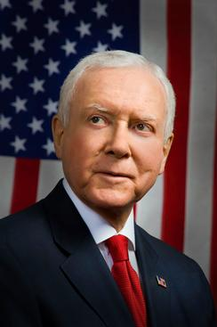
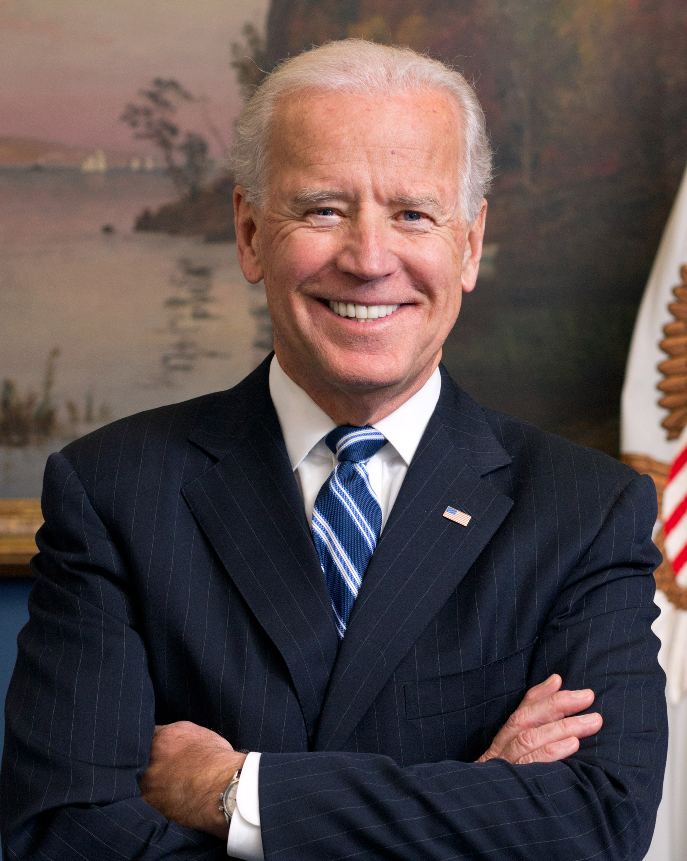
Joe Biden and Orrin Hatch

Slide 9
Powers of the Legislative Brach
Main role is to create and make laws
Vacancies- if there is a vacancy there is a writ of election held (ASAP) to elect a new representative (HOR and Senate)

Slide 10
Impeachment
HOR bring the charges against the President
Senate acts as the jury
Chief Justice of the Supreme Court presides over the hearings (trial)

Slide 11
Reasons for Impeachment
Treason-the crime of betraying one's country, especially by attempting to kill the sovereign or overthrow the government.
Bribery
High crimes (Felonies)
Misdemeanors
All public officials can be impeached if found guilty under any of these reasons

Slide 12
Punishment for Impeachment
Removed from office, forbidden from holding public office again
Can be charged with a crime if a law was broken.

Slide 13
3 Presidents
Andrew Johnson- firing his Secretary of War (tenure of Office Act)
Richard Nixon- Watergate Scandal
Bill Clinton- having an affair with a secretary

Slide 14
Should we have impeached these 3 Presidents?
Andrew Johnson
Richard Nixon
Bill Clinton

Slide 15
Sessions of Congress
Congress shall be held at least one time during the year.
Usually Congress in session for approx. 150 days a year

Slide 16
Rules &Procedures
For the quorum of congress to meet there must be a majority of Congressman
Can expel a member with a 2/3 votes and punish members for disorderly behavior
Records will be kept for all proceedings of a session of Congress
Must have the approval of the other house of Congress to adjourn

Slide 17
Payment & Privileges
Representatives form both houses make about $150,000 a year
Representatives- free from being arrested unless charges of treason, felonies, or a breach of peace
Cannot hold any other office while serving as a representative

Slide 18
Powers of Congress
Taxation | Borrow Money | Regulate Trade
Coin Money | Punish Counterfeiters | Establish Post Offices
Patents/ Copyrights | Can form lower courts | Punish Piracy
Declare War | Raise/support an Army | Provide for a Navy
Establish rules for the Military | Can call forth a militia | Creates laws for the District of Columbia

Slide 19
Powers denied to Congress
Slave trade ended on 1808
Habeas Corpus- cannot be arrested and put in jail without formal charges
Cannot create a law and punish someone who committed the crime before it was law

Slide 20
Cannot tax any goods exported from any state
No favorites- states
Public money- all public money shall be recorded for the public to view
No titles of nobility to anyone

Slide 21
Powers denied to the States
States cannot enter into treaties or alliances
Cannot coin their own money
No import or export taxes without the consent of Congress

Slide 22
Peacetime/ war restraints- cannot keep troops or warships during peacetime
Cannot engage in war unless the state is invaded

Slide 23
Executive Branch
Requirements;
35 years old
Natural Born Citizen
Lived in the United States for 14 years
Can serve 2 consecutive 4 year terms

Slide 24
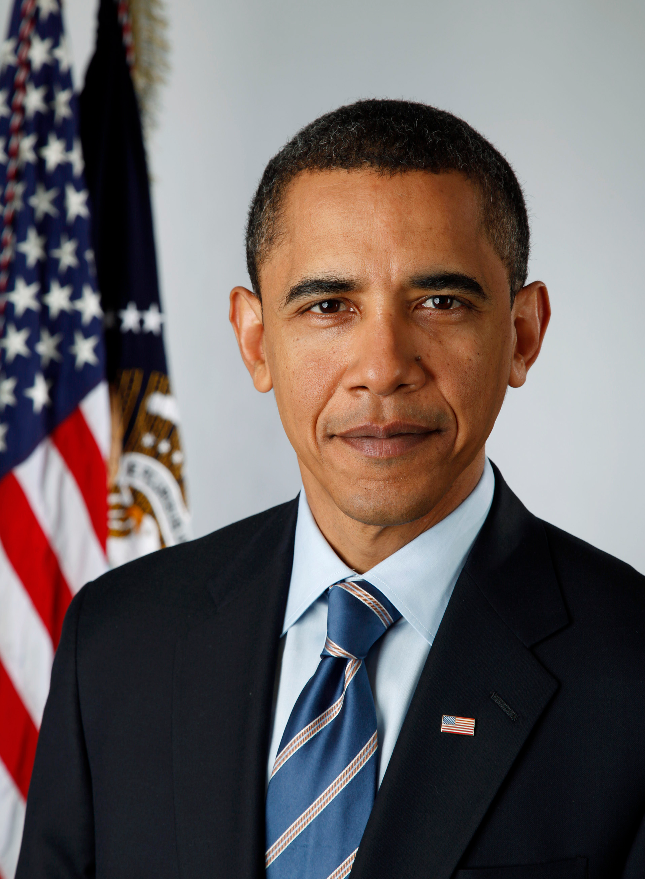

Slide 25
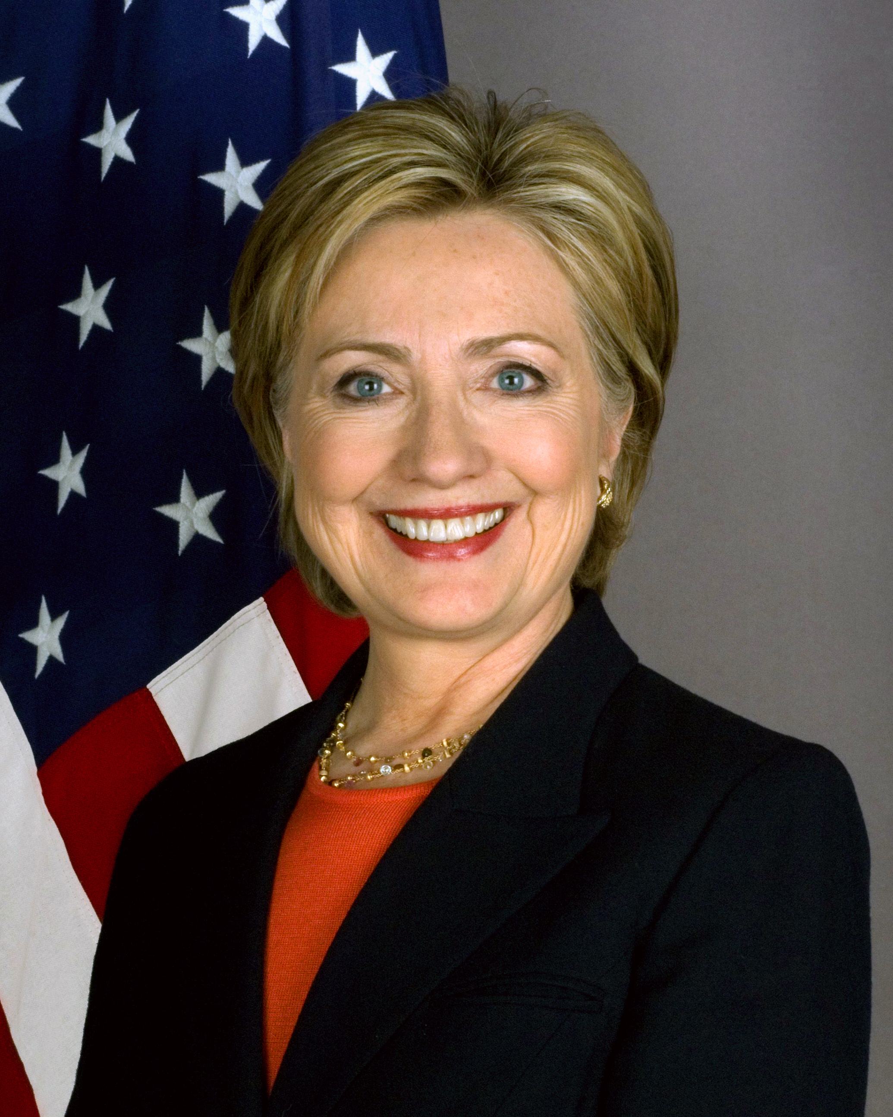
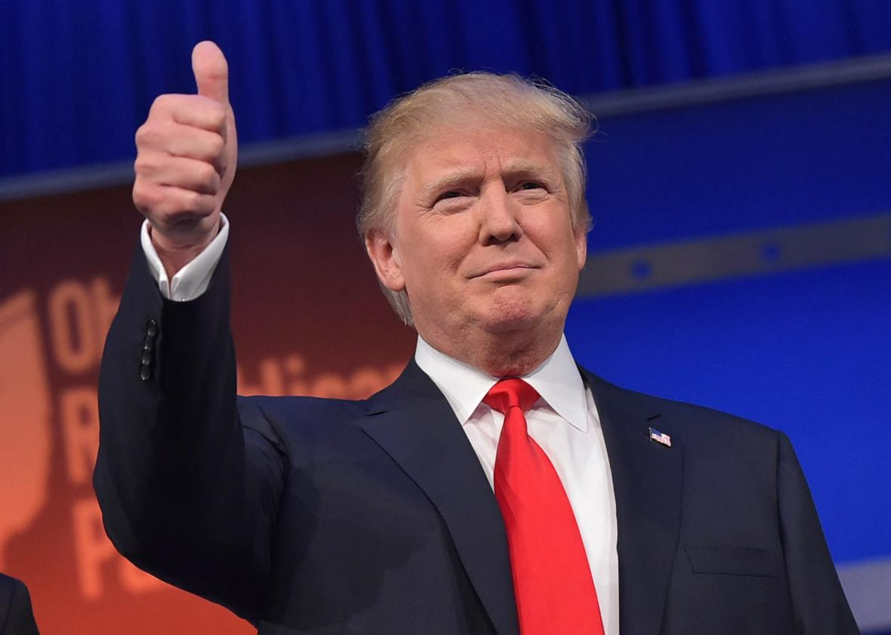

Slide 26
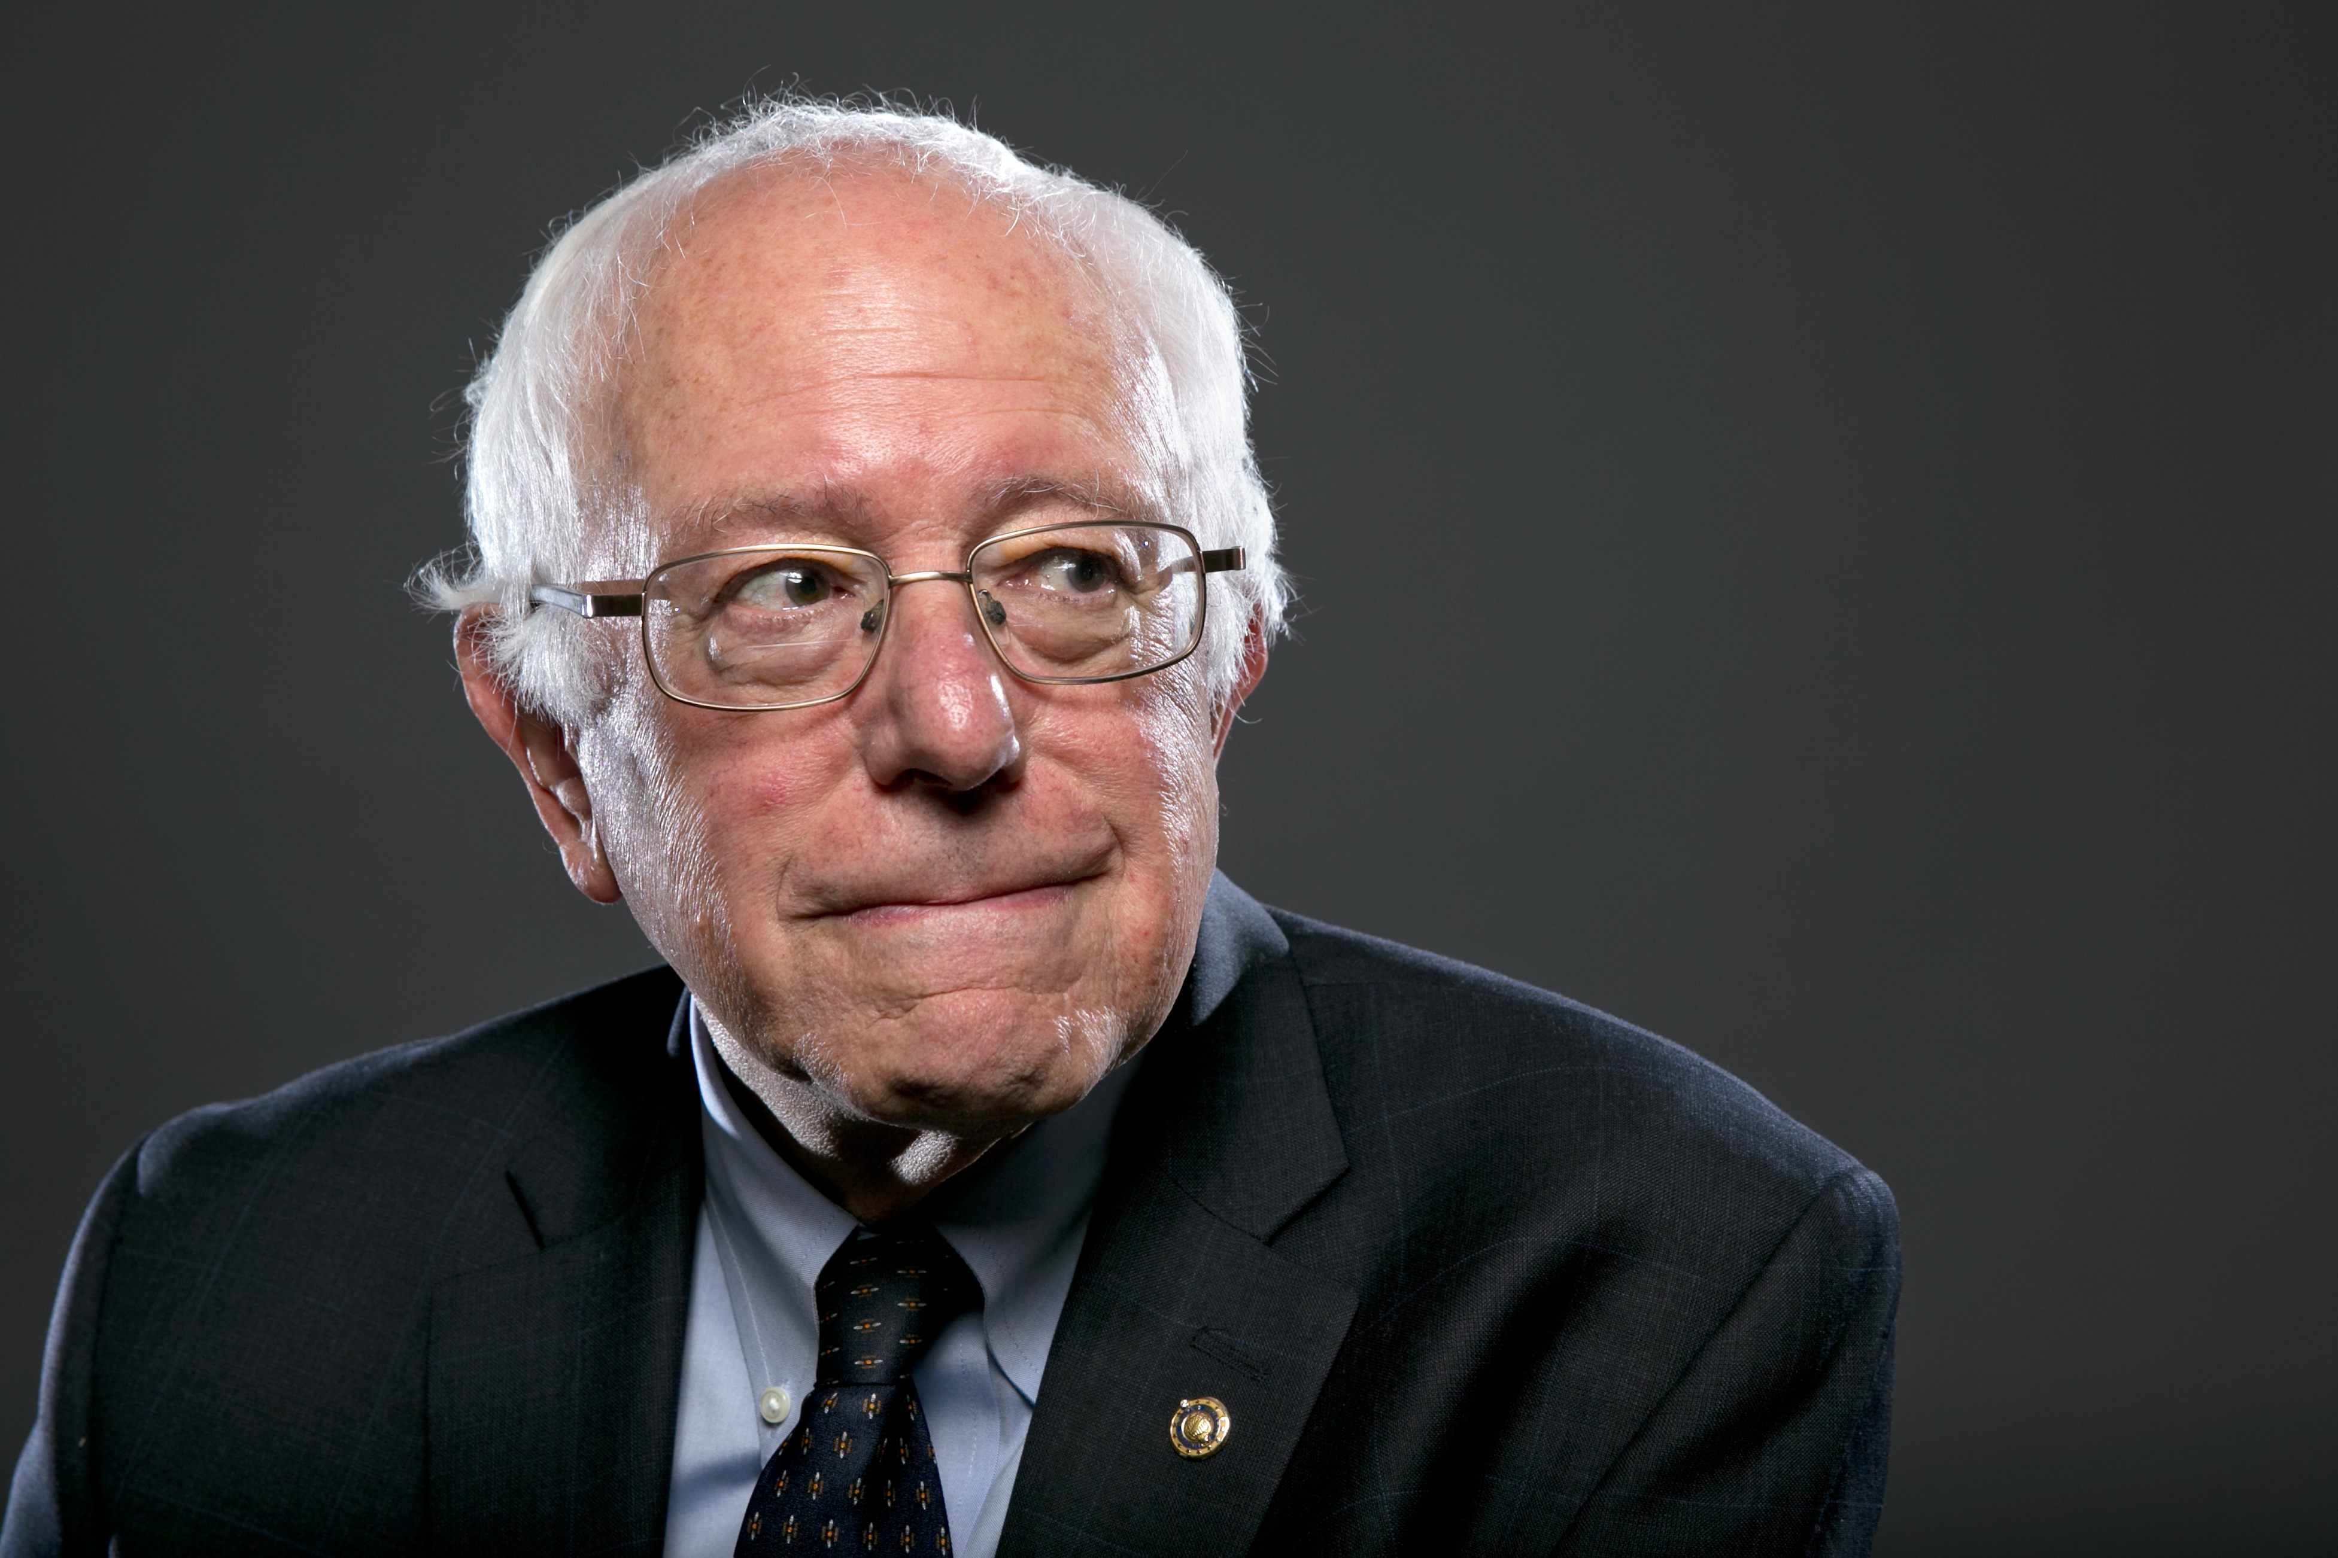
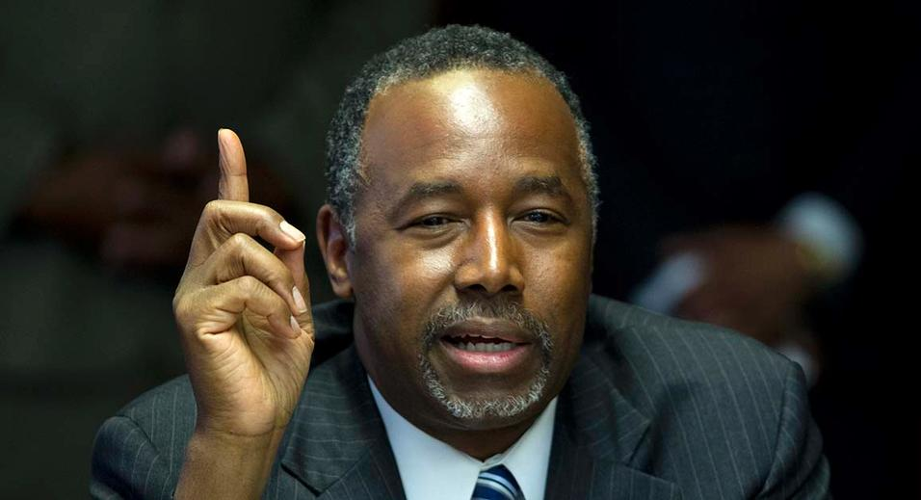

Slide 27
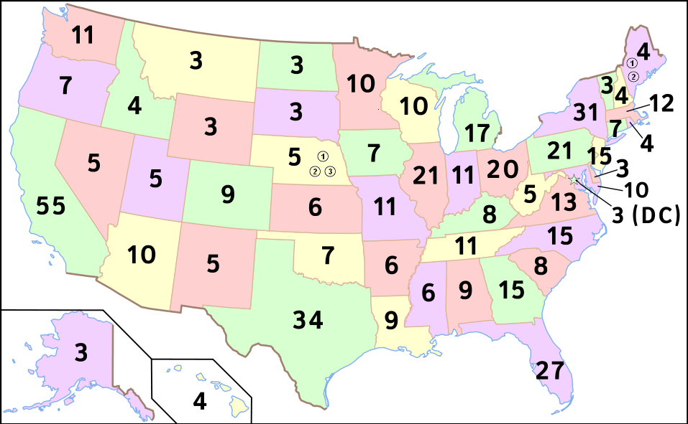
Electoral College

Slide 28
The # of representatives and senators each state has is how many votes they have for the presidential election.
The people of each state vote and which ever candidate has the majority of votes in that state is who the appointed individuals vote for.
Idaho has 2 Senators and 2 Representatives in the HOR. How many votes do we have for the President?

Slide 29
Vice President
Used to be the Presidential Candidate that came in 2nd in votes
Now the Presidential Candidate picks his VP

Slide 30
Election Day
The 1st Tuesday after the 1st Monday of November
November 8, 2016
Doesn’t take office until January 20 after the election

Slide 31
Salary of the President
$400,000 a year
Allowances for travel
Live in the White House
Vacationing at Camp David
Private Plane (Air Force One)
Free Medical Care

Slide 32
Succession of the President
What happens if the President dies or cannot perform his duties as President
VP- Joe Biden (D)
Speaker of the House- Paul Ryan (R)
President pro tempore- Orrin Hatch (R)
Secretary of State- John Kerry (D)

Slide 33
Powers of the President
Must take an oath of office
Commander and Chief– during war
Grants reprieves or pardons
Creates treaties with the advice of the Senate
Shall give yearly State of the Union address

Slide 34
Recommend legislation
Call special sessions of Congress
Appoint Supreme Court Justices (approved by Senate)
Make sure all laws are faithfully executed

Slide 35
Judicial Branch
All courts have power to make decisions in cases brought before them
Person v. person
Person v. state
State v. state
Person v. constitution
State v. constitution

Slide 36
Supreme Court
The Supreme Court can review any and all decisions made by lower courts on the basis of constitutionality. (appellate)
Will try all cases involving public ministers, ambassadors, and consuls

Slide 37
Your rights in court
Trial by a jury of your peers
Tried for the crime in which the crime happened
if a crime is not committed in a state, Congress will decide where the trial happens

Slide 38
Judicial Review
This is where the Supreme Court takes any legislation or executive order and reviews the law and decides whether or not it is constitutional or not

Slide 39
