Slide 1
Activity
Use a piece of paper and draw what you think the first people to come to America looked like?
You can use my colored pencils and markers, and a piece of cornell note paper

Slide 2
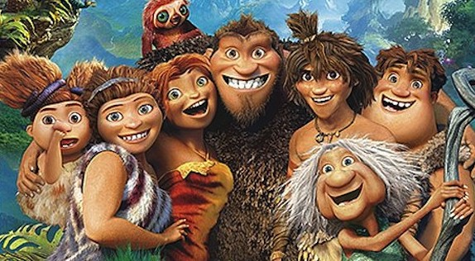

Slide 3
Crossing to the Americas

Slide 4
EQ
How is survival in the past different than survival today?
Have all the changes been for the best?

Slide 5
Brainstorm
Where did the first people in America come from?
How did they get here?
How did they survive?

Slide 6
Vocabulary
Using the books to define the following words;
Archaeologist Artifact
Civilization Crusades
Culture Domestication
Feudalism Iroquois League
Irrigation Matrilineal
Migrate Muslim
Profit Reformation
Renaissance Slash-and-burn agriculture
Technology

Slide 7
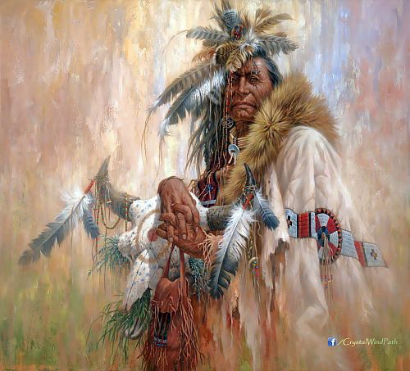
Theories
Some Native American’s believe they were created by a great spirit and put in the America’s.

Slide 8
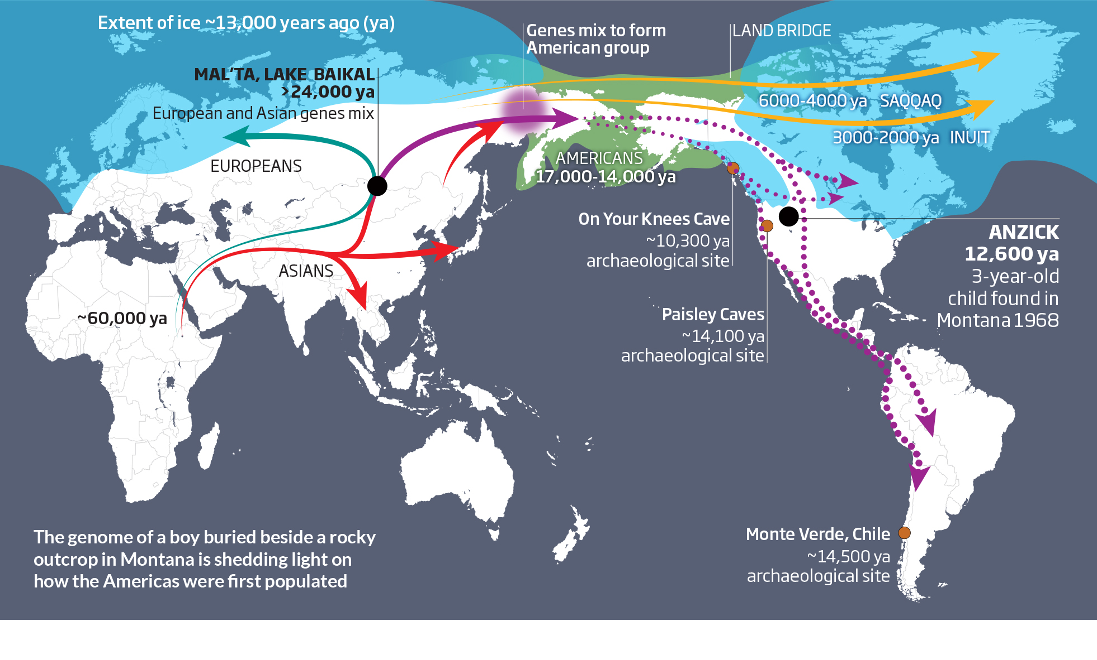
Bering Strait Theory
The last ice age people came across a land bridge connecting Asia to the Americas
12,000 years ago

Slide 9
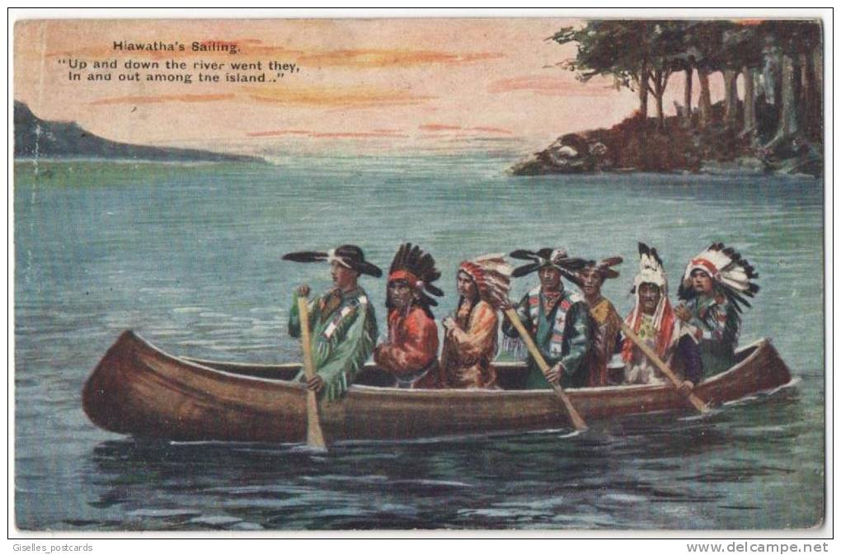
3rd Theory
30,000 years ago
People came to South America by boat
From one island to another
Don’t make me turn this canoe around!
Are we there yet?

Slide 10
What is your favorite food? What do you think your favorite food would have been 1,000 years ago? What about 12,000 years ago?

Slide 11
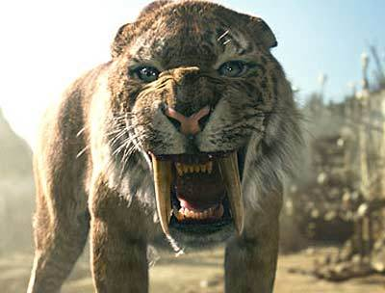
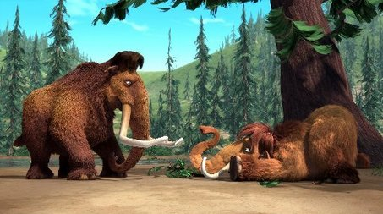
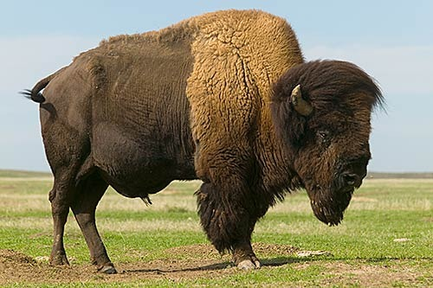
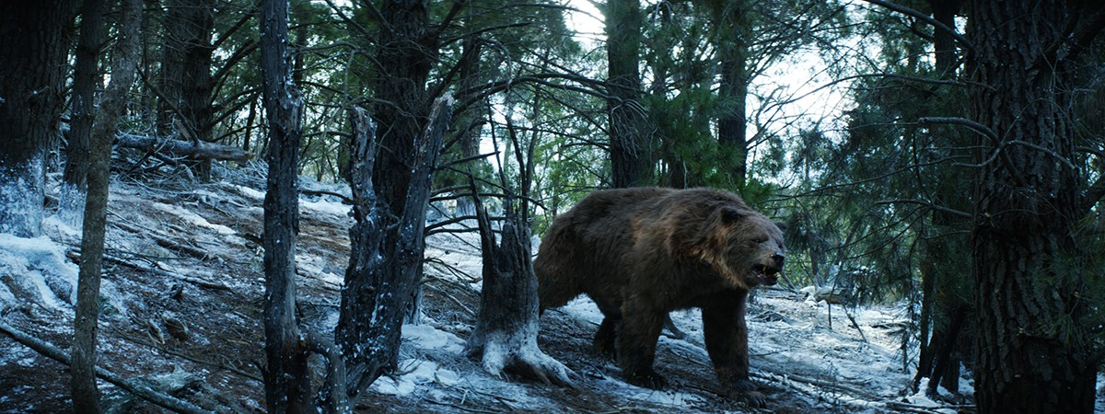
How did they survive?
12,000- 9,000 BC

Slide 12
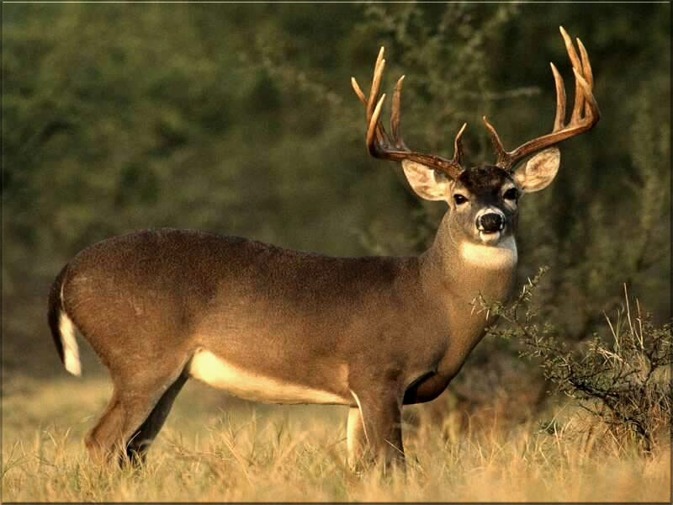
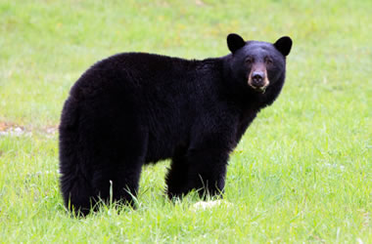
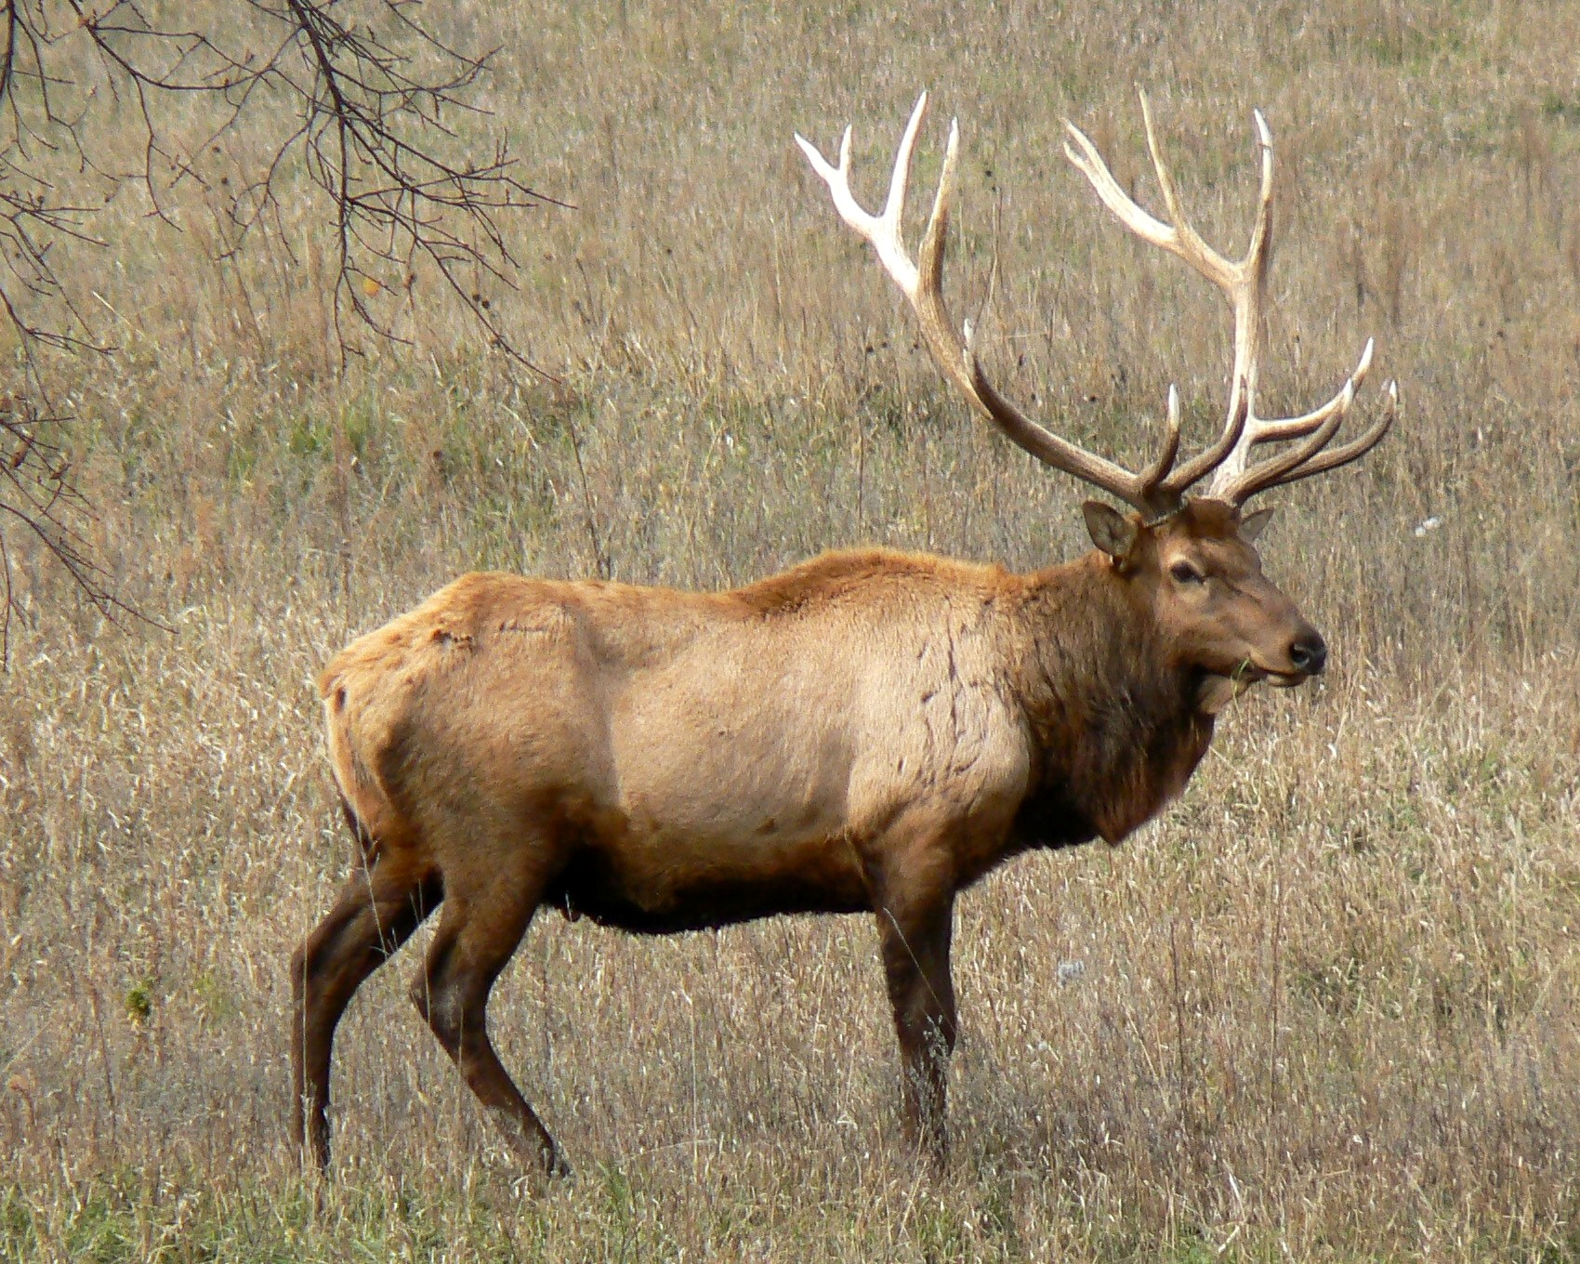
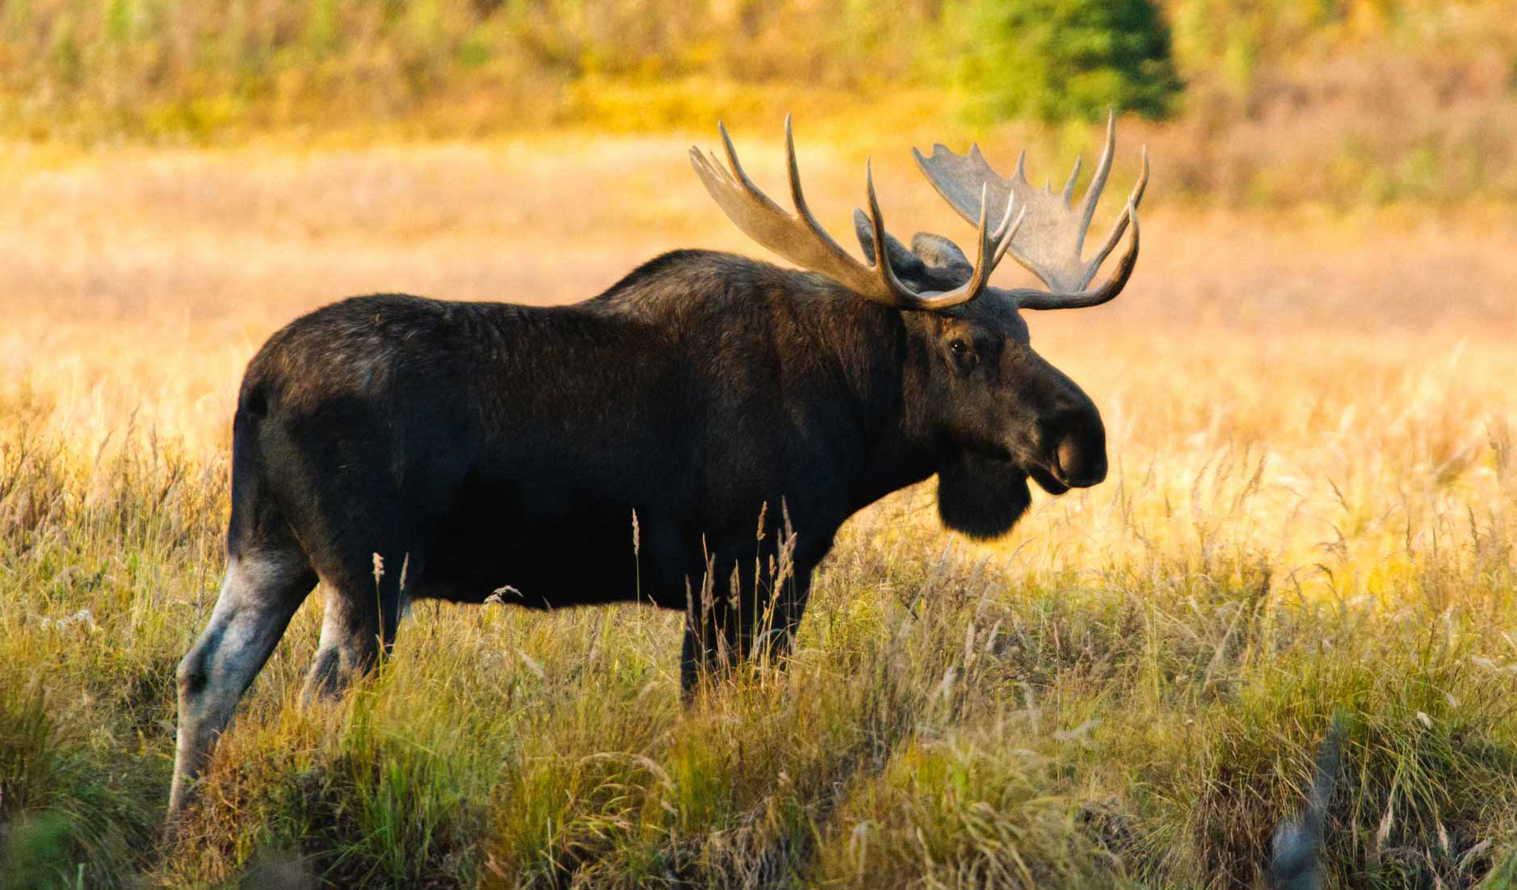
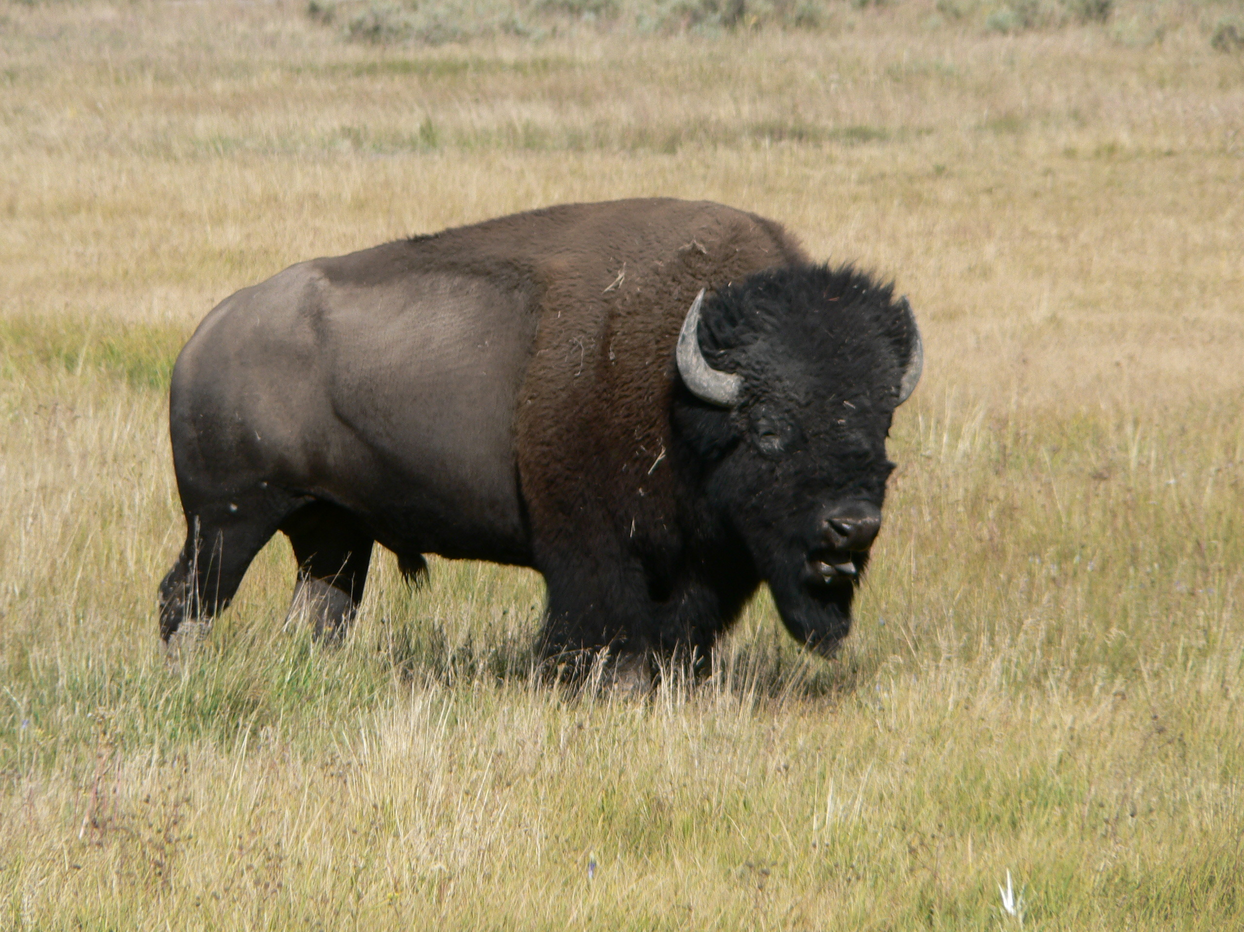
9,000-2,500BC

Slide 13
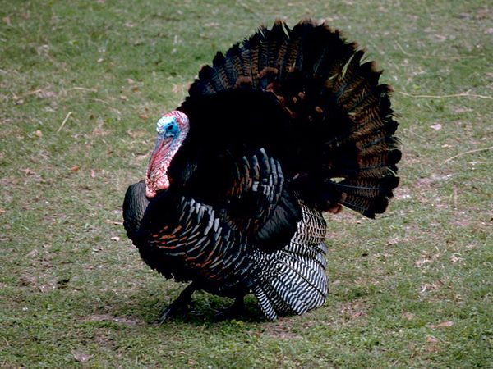
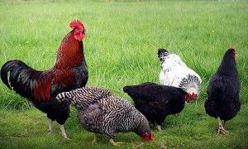
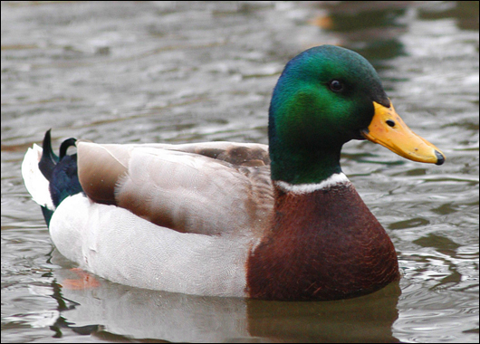
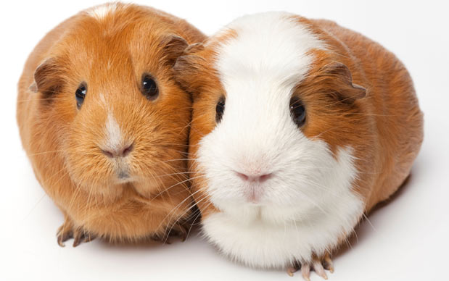
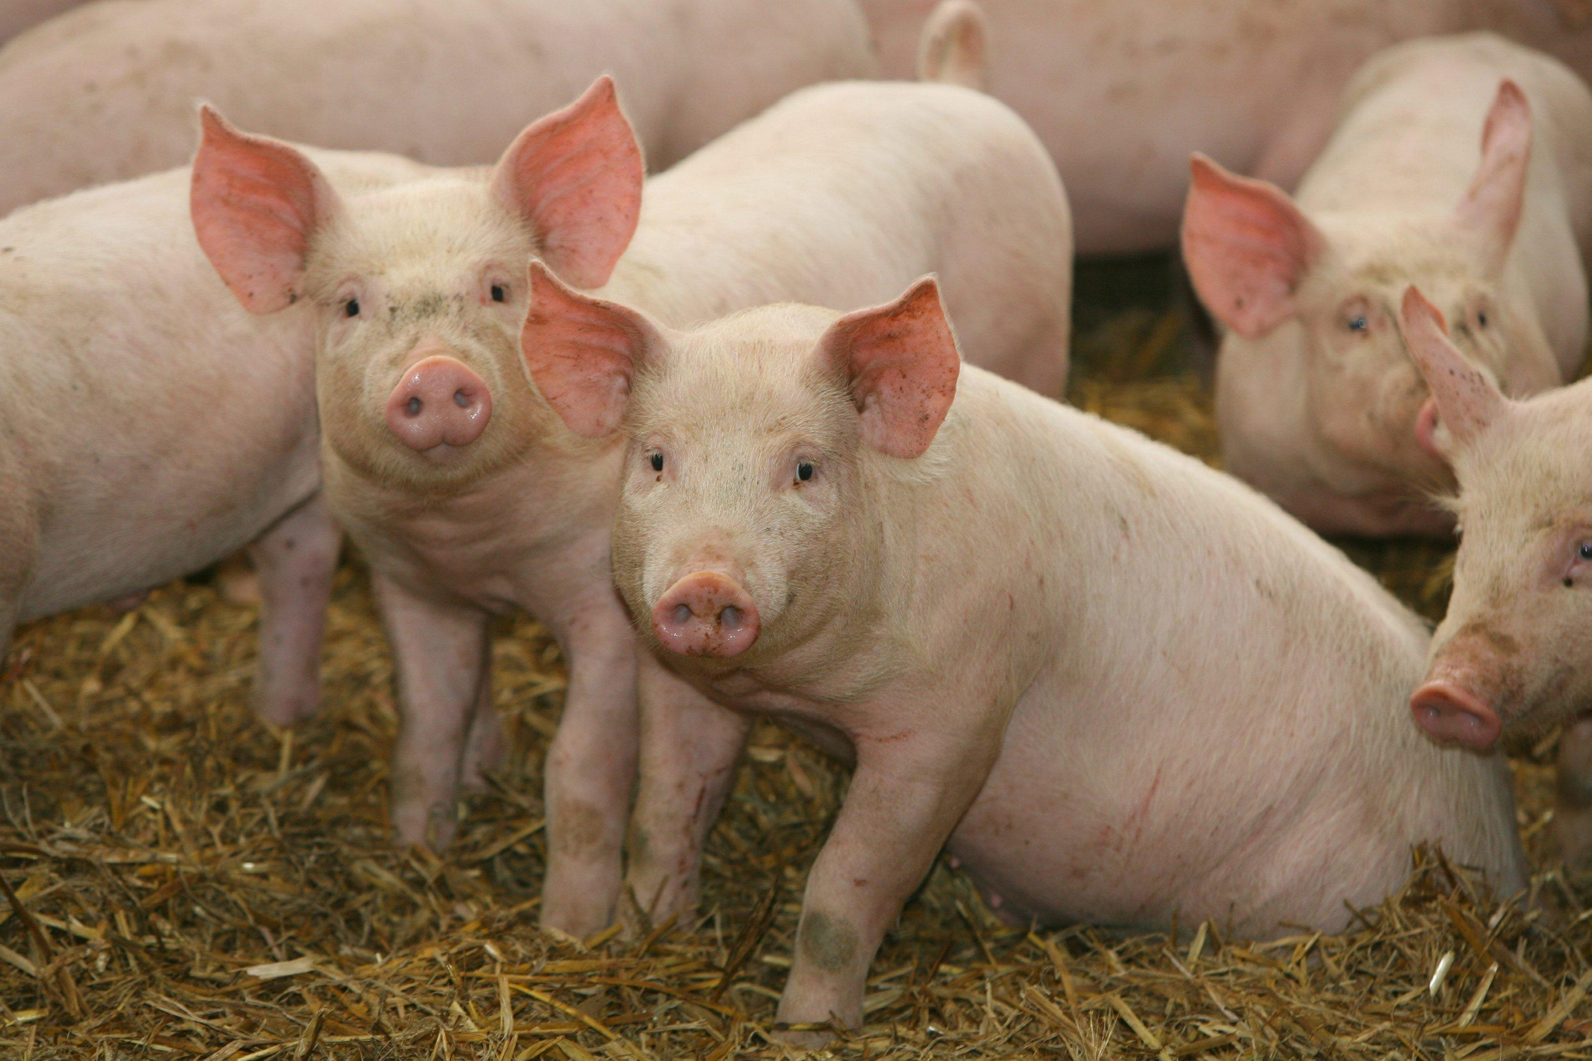

Slide 14
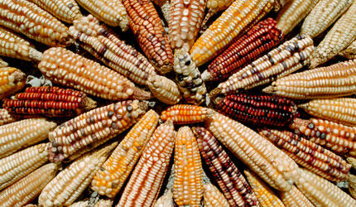
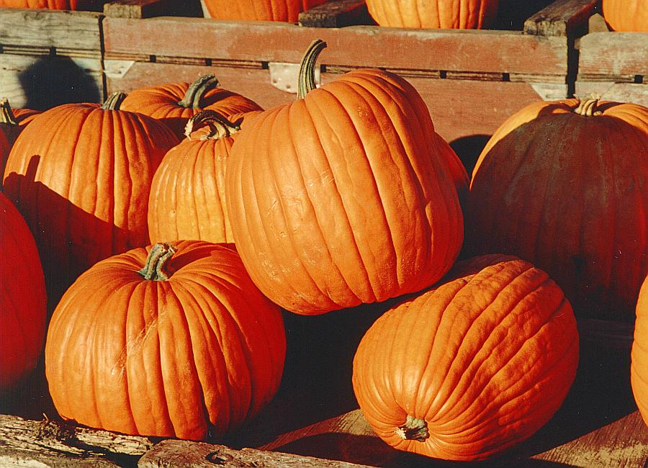
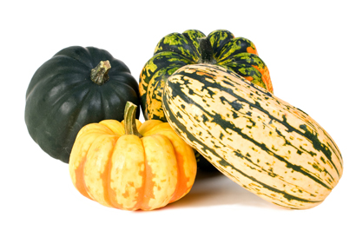
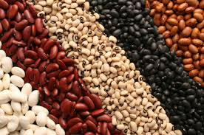
Approx. 7,000 BC
About this time worldwide cultivating and harvesting of plants started.
Why?
Maize
Squash
Pumpkins
Beans

Slide 15
Questions to answer in your notes
According to the video what crop led to successful tribes and villages in the Americas?
Corn
The Incan Empire is mostly known for its gold, but what made the Empire successful was what?
Potato
What made farming different in Europe than in the Americas?
In Europe they used Animals to help farm where as in the America’s they used man power

Slide 16
How does Europe grow the same amount of food as the Americas in a 1/10 the space?
They domesticate animals to use in the fields and as a food source
Which Animals did Europe domesticate? (Big 5)
Horses, cows, pigs, goats and sheep
What was Europe's main crop in the 1400’s and 1500’s?
Grains, wheat and rye
What does it mean to have a field lay furrow?
When you do not plant in a field so that it can regain nutrients
What is the difference between hunting in the America’s to hunting in Europe?
In America you hunt to survive, in Europe it is a sign of status (only the nobles hunt)

Slide 17
Size of countries
Great Britain= 94,058 square miles
Peru= 496,200 square miles
Mexico= 761,600 square miles
United States of America= 3,806,000 square miles (Europe 3.931 mil)
Why does size of these countries matter in the 1300-1400 hundreds?

Slide 18
Effects of Farming
Natives no longer Nomadic ( constantly moving)
Live in villages and cities
Constant food and diversity in food

Slide 19
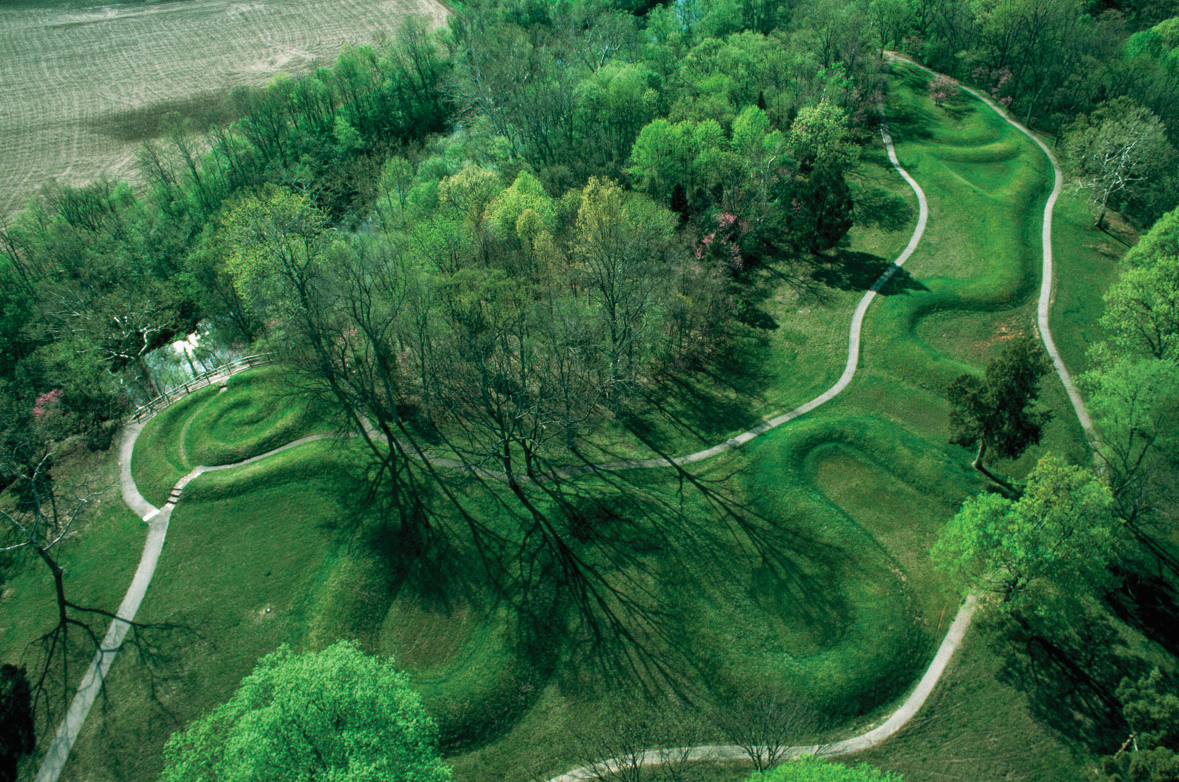
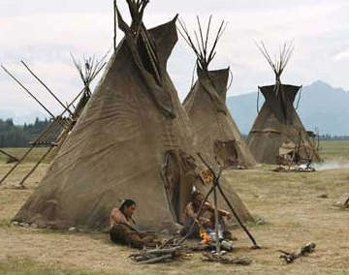
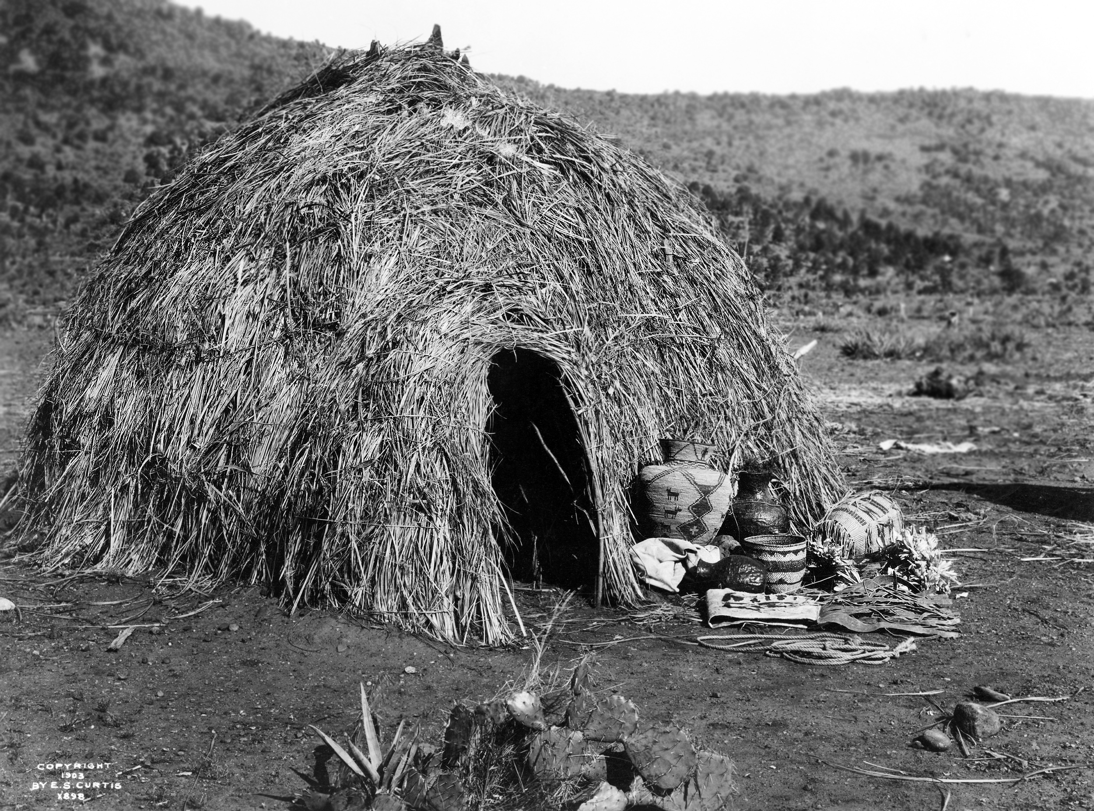
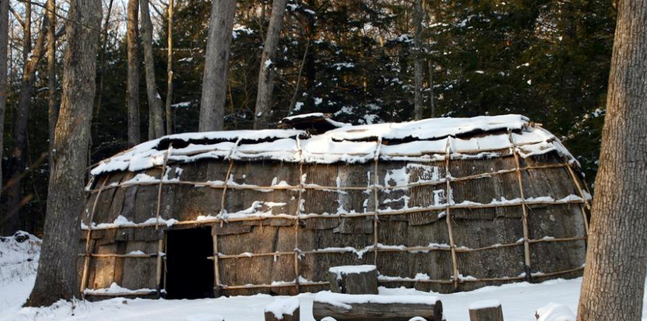
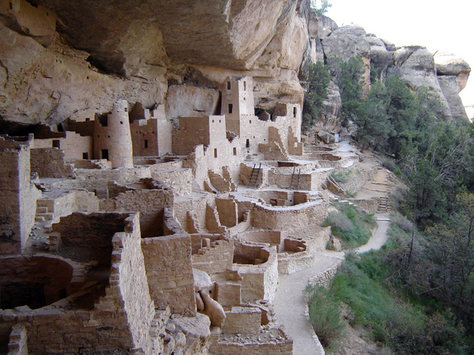
Shelters

Slide 20
Survival in Regions
Northwest Coast
Mostly fishing( salmon, whales, seals and walruses)
Traded shells and other coastal products for furs
West
Relied on hunting and gathering
Men hunted animals women gathered berries, nuts and seeds

Slide 21
Southwest
Used irrigation to grow crops like corn, beans and squash
Hunted and raised turkeys
Some tribes were nomadic( Navajo and Apache)
Great Plains
Nomadic tribes that followed the buffalo
Some lived by rivers and farmed
Southeast
Women farmed, men hunted
Men sat in the meetings but women ran the tribe

Slide 22
Eastern Woodlands
Slash-and-burn agriculture
Cut down and burn trees and plants then use the enriched soil for farming
Hunting and fishing( Pocahontas)
Forming of the Iroquois League
Cayuga, Mohawk, Oneida, Onondaga and Seneca were always fighting amongst each other
A peace seeking man named Deganawida brought the five tribes together and formed a peace treaty
A council of leaders from each tribe governed the League
Women could vote men out of office if they didn’t like what he was doing

Slide 23
Questions
List 3 things in your notes that are similar between the tribes in North America
Hunting, Farming, Matriarchal, adapt to where they live and most tribes become stable or live in one place
2. What does it mean when someone says a tribe is matriarchal?
Use your own words
It means that they trace lineage through the mother and women really make the rules

