Slide 1
Growth of the American Colonies

Slide 2
EQ: What are the benefits of becoming more independent in your life?
How would independence benefit the colonies?

Slide 3
Vocabulary
Albany Plan of Union
Apprentice
English Bill of Rights
Enlightenment
Glorious Revolution
Great Awakening
Magna Carta
Parliament
Salutary neglect

Slide 4
The Power of Land
Only 5% of English citizens owned land
The colonies had access to cheap land
Colonists to use or sell whatever their land produced.

Slide 5
High:
Large Landowners
Church Officials
Government Officials
Wealthy Merchants
Upper Middle:
Small Farmers
tradespeople
Lower Middle:
Renters
Unskilled workers
Low:
Indentured Servants
Slaves
The Majority of colonists were in this group

Slide 6
Land= Political Rights and wealth
Land ownership= white males
City dwellers pay to vote
Women have same class as husband or father

Slide 7
Lower classmen would tip their hats and curtsy upper classmen
The front seats of churches reserved for upper classmen
Wealthy still expected to help the poor

Slide 8
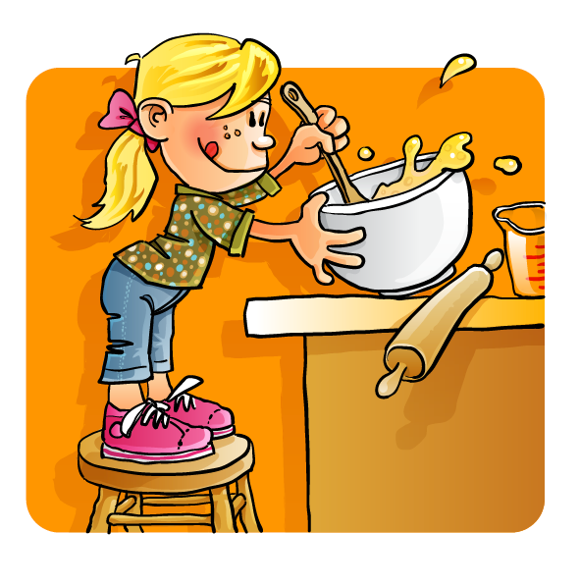
Women and the Economy
Work was essential to the success of the colonies.
Cooked, cleaned, churned butter, made soap, candles, wove cloth, sewed, knitted clothes and many other chores

Slide 9
Women would trade services like helping birth a baby for sugar or cloth
Women in cities ran inns, or other businesses selling paper (Any property owned or money earned belonged to the husband)
Women became more independent but not allowed political rights or the ability to preach a sermon in religions
Vote

Slide 10
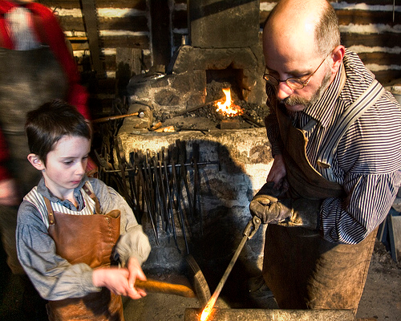
Children
Boys would start working as early as 3
Age 6 boys started working with their fathers farming or in shops
Age 11 boys would become an apprentice to learn a specific trade

Slide 11
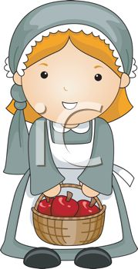
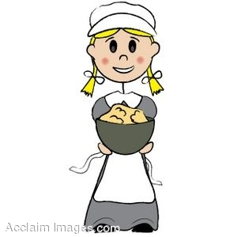
Girls would start working at age 3 doing chores around the house
Age 13-14 girls were sent to other households to learn specialized skills like weaving or cheese making

Slide 12
Education
All children taught to read using the bible as the textbook
Wealthy children taught arithmetic and writing
poor families relied on mothers to teach children to read

Slide 13
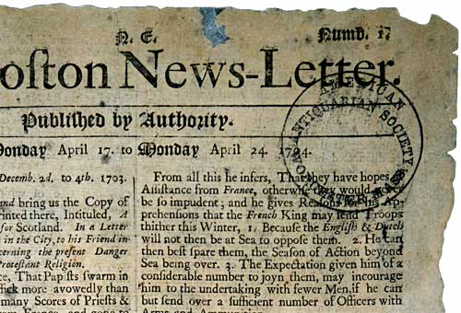
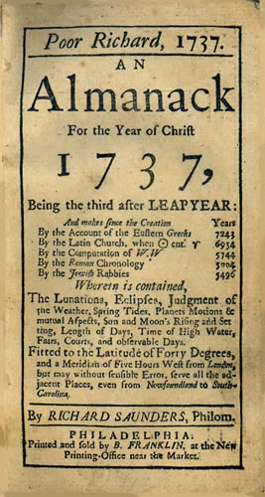
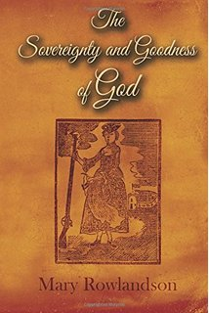
Books and Newspapers

Slide 14
Great Awakening vs. Enlightenment
Religion had become something the colonists did just to do.
Ministers come in and supercharge religion to bring back the importance.
Encouraged ideas of equality and the rights to challenge authority.

Slide 16
Enlightenment emphasizes reason and science over religion to find answers
Affected mostly the wealthy, educated men

Slide 17
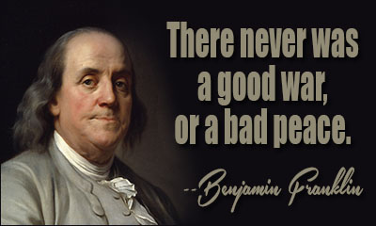
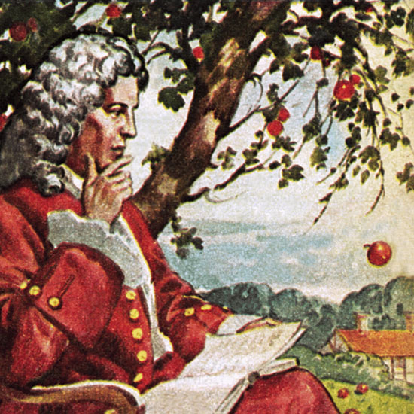
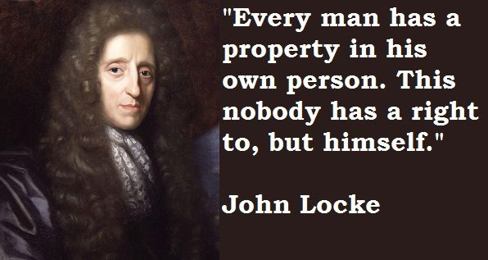
Benjamin Franklin was a leading Enlightenment figure in the Colonies
Sir Isaac Newton explains the law of gravity
John Locke argues that people have natural rights

Slide 18
Write 2 sentences answering the following question.
Since we have been discussing a new identity in the colonies, describe what your identity is. How would you describe yourself to someone?

Slide 19
What are natural rights?
Who has natural rights?
How is this idea different than how European governments have been ran in the past?

Slide 20
Beginnings of Representative Government

Slide 21
EQ; Which government is better; monarchy or representative government?

Slide 22
Monarchy | Representative Government
One person rules over the city, state or country.( Kings, Dukes, Lords, etc.) | A group of people rule and make decisions for the city, state or country. (Congress)
All laws are made through one person | The group make laws that represent what the citizens of the city, state or country want rather than what one person wants.
This person is the judge, jury | A separate branch of government is set up to judge and decide the fate of those that have broken laws
Laws are made to protect and benefit one person rather than the whole | Laws are made to protect and benefit the citizens not the ruling class

Slide 23
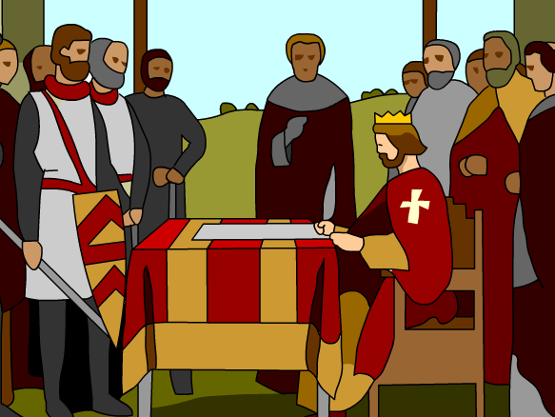
Establishment of the Magna Carta
In 1215, English nobleman force the King to sign a document protecting the nobles from King John.
Magna Carta= Great Charter

Slide 24
Protections received
The King couldn’t seize property
Couldn't be taxed without a group of prominent men agreed to it
They could not be tried for a crime without witnesses
They could only be punished by a jury of their peers (same social class)
Eventually every Englishman would receive these rights

Slide 25
Parliament
Created to elect representatives to government.
2 houses; House of Commons (elected by the people) and House of Lords (Non elected officials; nobles, judges and church officials)

Slide 26
The House of Burgesses( Virginia) and General Assembly(Pennsylvania) were like the House of Commons.
Colonies didn’t have any representation in Parliament, but were expected to follow laws from Parliament
Explain why this is not right.

Slide 27
Glorious Revolution
Why; King James (Catholic) creates laws supporting Catholics and nobody else
Protestant Parliament offers the throne to William and Mary.
King James flees from England

Slide 28
William and Mary sign the English Bill of Rights
Limits the power of the Monarch and gives the rights to Parliament and the people

Slide 29
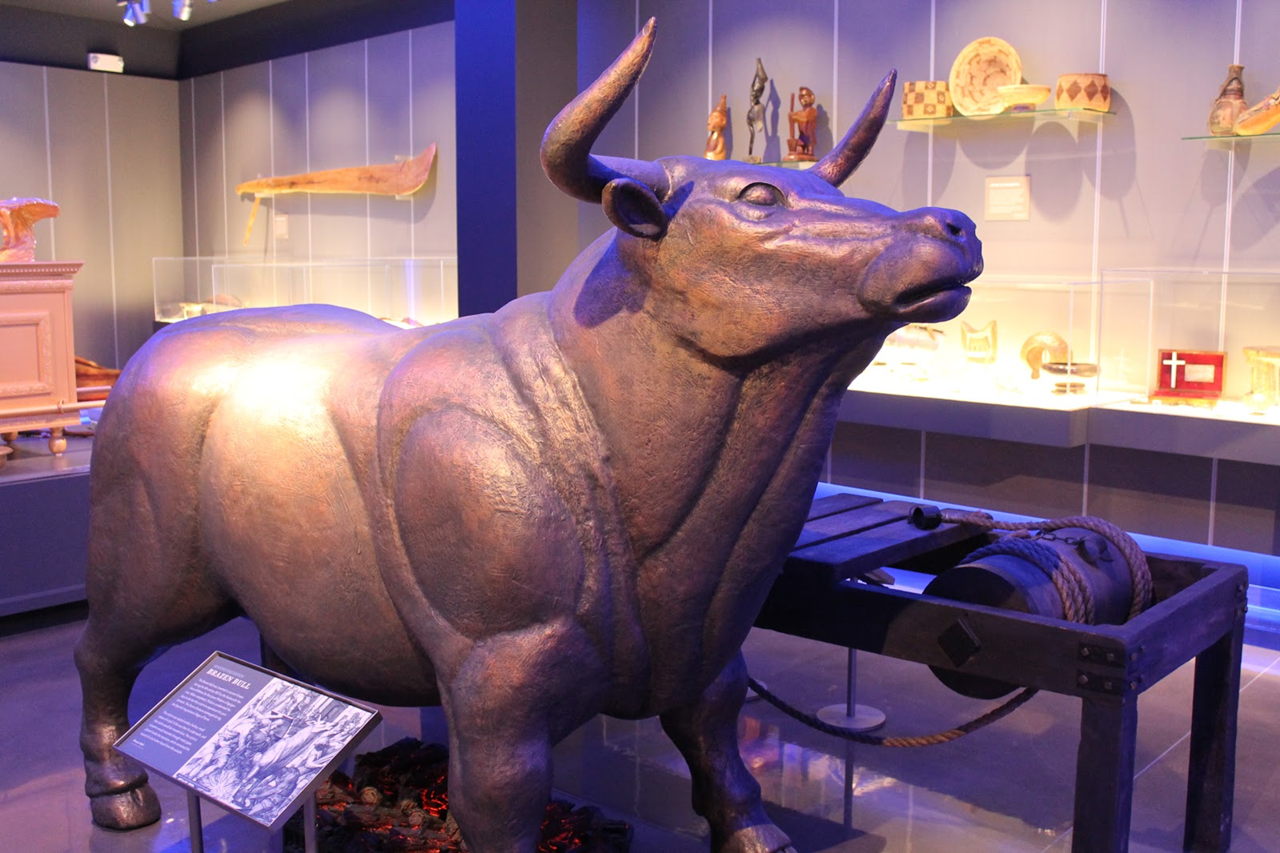
King cannot cancel laws
King cannot impose taxes
No excessive fines
No cruel punishments
Free to complain to the King or Queen without fear of being arrested( Sounds like freedom of speech)
Must have the consent of Parliament

Slide 30
Royal Governor;
Appointed by the king
Oversaw trade
Final say in laws
Dismisses the assembly
Council;
Appointed by the governor
Advisory board
Highest court in each colony
Colonial Assembly;
Elected by eligible colonists
Made laws
Authority to tax
Paid governor’s salary

Slide 31
King
King appoints a Governor
Governor
Advisory Council (UH)
Prominent colonists picked by the King
Governor appoints the legislature
Colonial
Legislature
Legislature divided into 2 groups
Picked by qualified voters
Lower
House
Any white adult male owning land was qualified

Slide 32
Trade Laws
Colonies provided:
fur, lumber and tobacco to sell.
Navigation Act- colonies had to sell sugar, tobacco and cotton to England. (other goods as well)
Had to use English ships

Slide 33
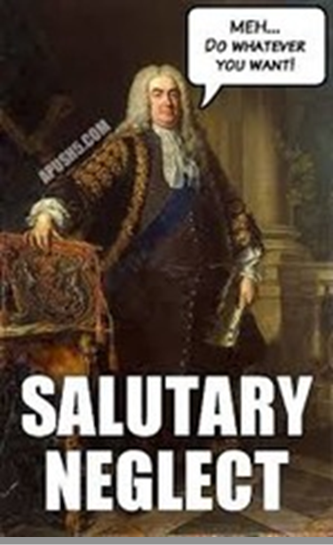
Salutary Neglect
Parliament passes laws regulating trade, but England and the colonists are becoming so wealthy these laws are rarely enforced.

Slide 34
Should Britain have had more control over the colonies or kept the practice of Salutary Neglect?
Think about how your parents monitor you.
Lots of rules or few rules and allow you to govern yourself.

Slide 35
Which is the easiest way to govern, Monarchy or Representative Government?
In 2 sentences explain which one is best and why.

